Slide 1
Order5: Tuberales
are mycorrhizal fungi living in association with the roots of Oak and beech-trees. There are two families, Tuberaceae andTerfeziaceae, and two genera; Trimania and Terfezia.
The ascocarp surrounding by a thick-wall cells called peridium. There is a veins which contain the hymenial layer (ascospores) in Genus; Terfezia the acospores are globose and eight in number, and the wall is smooth,while in Tirmania , the wall is spiny and there are only four ascospores.

Slide 2
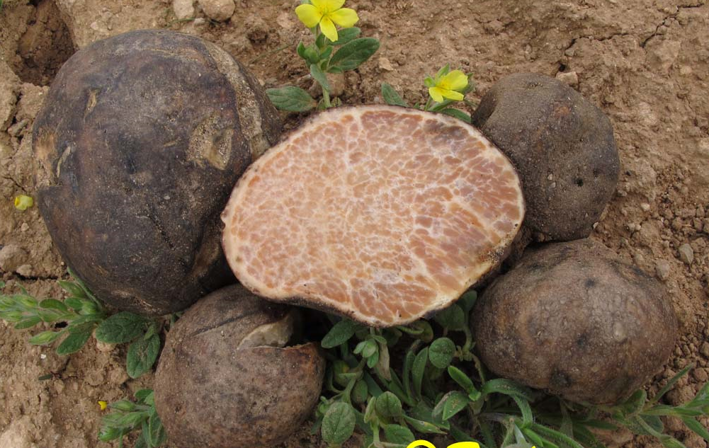
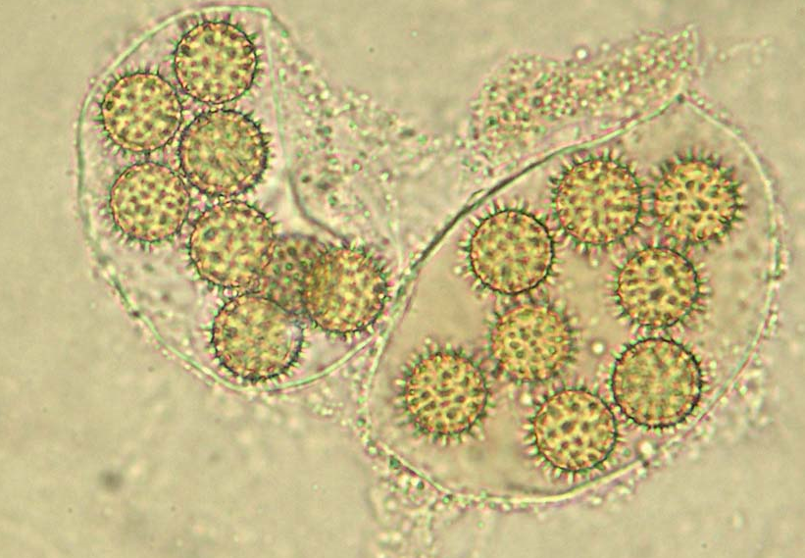

Slide 3
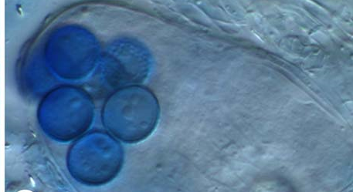
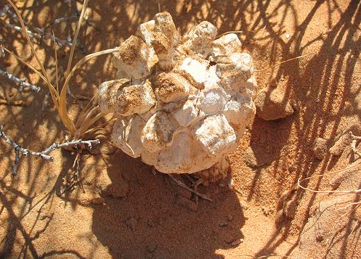

Slide 4
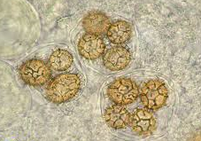

Slide 5
Subclass 4: Loculoascomycetidae
General characteristics:
The asci are bitunicate.
The ascocarps are ascostroma in which the asci are borne in locules.
Order: Pleosporales
Family: Venturiaceae
Genus: Venturia : is widespread, and contain an estimated 58 species

Slide 6
Species: V. inaequalis
is an ascomycetous fungus because it produces sexual spores (ascospores) in a sac-like structure called an ascus (plural asci). The mycelium of V. inaequalis is septate, and the nuclei are haploid.
V.inaequalis attacks apple fruits and causes apple scab. The fruiting bodies, ascocarps appear in the form of pseudothecia. They are solitary and embedded into the host plant tissue. A pseudothecium has small dark hairs around its opening, and contains pseudoparaphyses along with asci. The asci contain eight haploidascospores. The haploid chromosome number of V. inaequalis is seven.

Slide 7
